Slide 1
Sports coaching
Maths in the workplace

Slide 2
How our teaching resources are designed for the classroom

Slide 3
I can understand how maths is used by sports coaches.

Slide 4
Data are a collection of information.
An average is a single number expressing the central or typical value in a set of data; the mode, the median, and the mean.

Slide 5

Sports coaching
Recording and using data
Using data to plan training sessions

Slide 6



Recording and using data
Sports coaches use a lot of mathematics in their work. One thing they do an awful lot of is measuring!
Well done Sofia! You did that 800 in 2:16
Sporty Sofia
A measure of distance.
A measure of time.
Coach Lucas

Slide 7
Recording and using data
In fact, sports coaches and athletes are so familiar with their measures they automatically know what units are being used.
Well done Sofia! You did that 800 in 2:16
800 metres
2 minutes
Sporty Sofia
16 seconds
Coach Lucas
What units do you think Coach Lucas is using here?

Slide 8

Recording and using data
What units is Coach Lucas talking about here?
Well done Sofia! That long jump was 3.95
3.95 metres
3 metres,
95 centimetres
Sporty Sofia
Well done Aisha! You ran that half marathon in 1:57 That is an average speed of 7 mph
Athletic Aisha
1 hour, 57 minutes
7 miles per hour

Slide 9
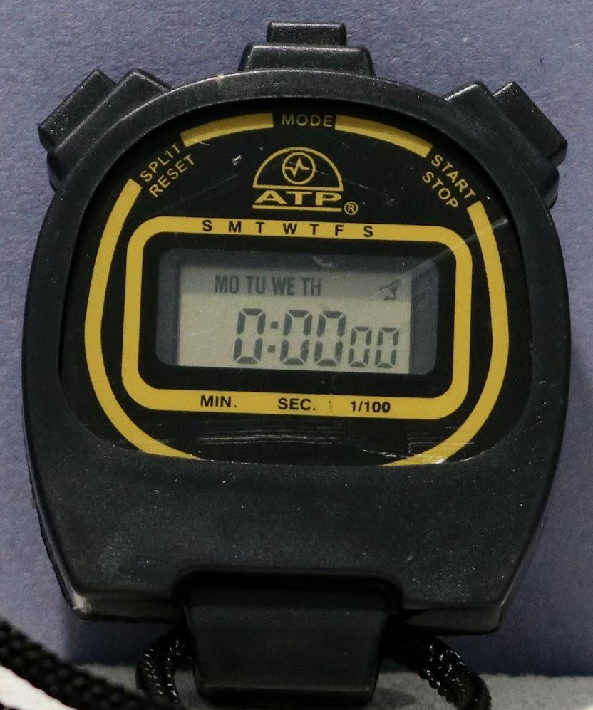
Recording and using data
Traditionally coaches have used devices like stopwatches to record performances.
These devices gave us limited information and it all had to be written down.

Slide 10
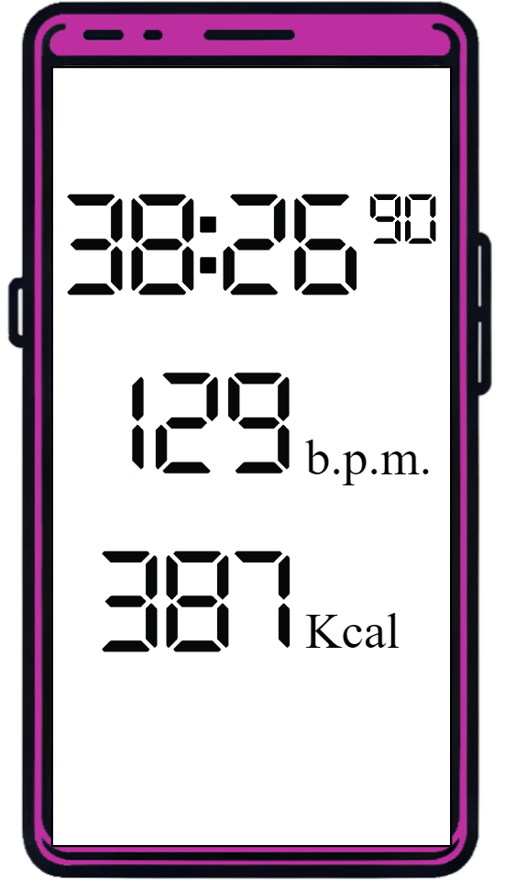
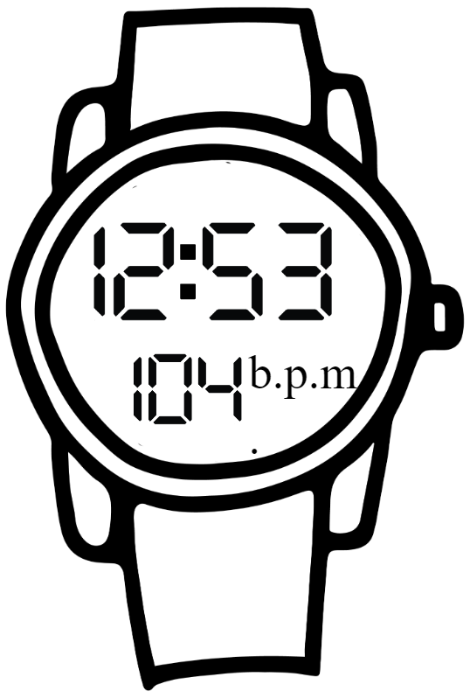
Recording and using data
Modern technology does a lot of the recording now.
The technology records a variety of data which coaches and athletes can use to monitor their performance.

Slide 11

Recording and using data
Which of these things do you think smart-tech can record for athletes and coaches?
Time taken
Distance covered
Speed
Average speed
Heart rate
Average heart rate
Calories burnt
Total hours trained
Smart-watches/Smart-phones are smart! They give athletes and coaches a lot of varied data to enable the analysis and improvement of performance.

Slide 12
Recording and using data
In sports we encounter some units we might not have seen before.
Kcal is short for kilocalories.
A calorie is a unit of energy that we get from food and drink. Teenagers burn between 1600 and 2400 every day.
Sporty Sofia
Sofia trains at high intensity three or more times a week and factors these extra calories she needs into her diet.

Slide 13
Recording and using data
In sports we encounter some units we might not have seen before.
b.p.m. stands for ‘Beats per minute’
This is the number of times your heart beats in one minute.
Sporty Sofia
Teenagers and adults will have a resting b.p.m. of 60 to 100
During exercise your b.p.m. increases
as your heart works hard to get oxygen to your muscles.

Slide 14
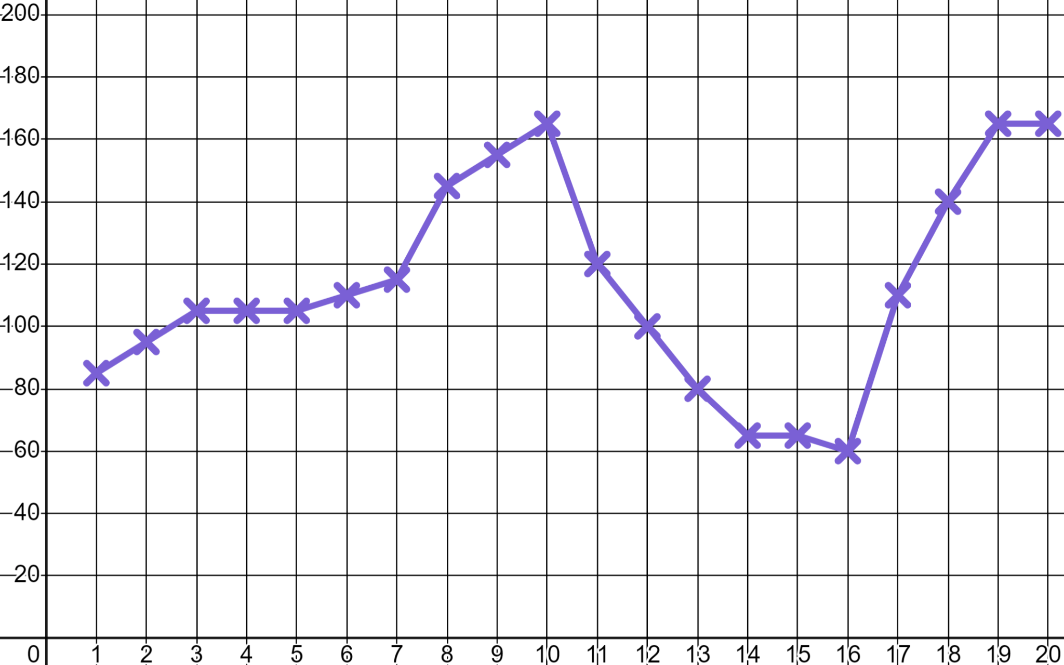
Recording and using data
Coach Lucas is using an app which has recorded and graphed Sofia’s heart rate during a training session.
When do you think Sofia was working at high intensity?
b.p.m.
High intensity
High intensity
Warming up
When do you think Sofia was stretching?
Stretching
Time (minutes)

Slide 15
Recording and using data
Sofia’s heart rate was as low as 60 b.p.m. and as high as 165 b.p.m. during her training session.
Let’s see if that is normal.
b.p.m.
Teenagers and adults have a resting heart rate of between 60 and 100 b.p.m. Athletes tend to be at the lower end of that scale with a lower heart rate.
Time (minutes)
During exercise your heart rate will rise.
But, what should we be aiming for?

Slide 16
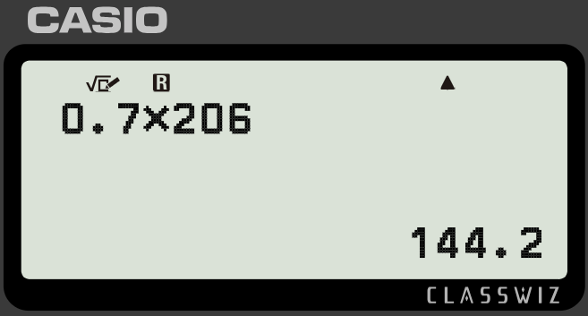
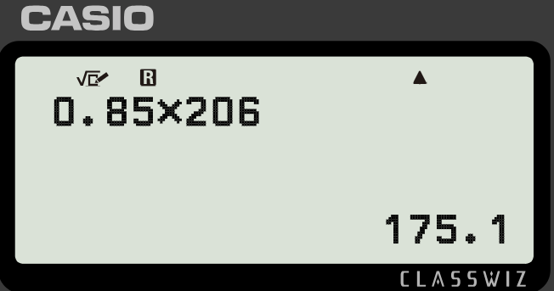
Recording and using data
To maintain a healthy heart it is important to raise your heart rate frequently through exercise. There is a calculation for target heart rate.
Your maximum heart rate is 220 b.p.m. minus age
Target heart rate for moderate exercise is 50 − 70% of maximum
Target heart rate for high intensity exercise is 70 − 85% of maximum
Sofia is 14 and was operating at high intensity.
Was 165 b.p.m. the right heart rate for her?
Max heart rate: 220 − 14 = 206 b.p.m.
70% value: 0.7 × 206 = 144 b.p.m.
At 165 b.p.m. Sofia was in the correct zone for intense exercise.
85% value: 0.85 × 206 = 175 b.p.m.

Slide 17

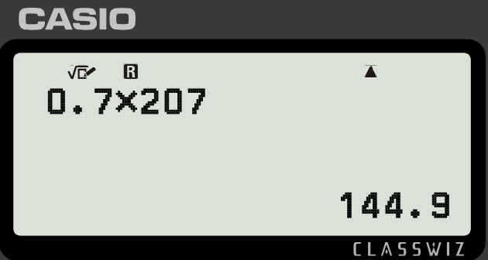
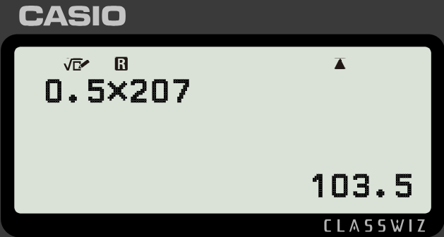
Recording and using data
Jacob is just taking up regular exercise. He wants to do moderate exercise three times a week and will count his heart rate.
Your maximum heart rate is 220 b.p.m. minus age
Target heart rate for moderate exercise is 50 − 70% of maximum
Target heart rate for high intensity exercise is 70 − 85% of maximum
Jacob is 13 What range for heart rate should Jacob be aiming for?
Max heart rate: 220 − 13 = 207 b.p.m.
Jacob should aim for a heart rate between 104 and 145 b.p.m. for moderate exercise.
Lower bound: 0.5 × 207 = 104 b.p.m.
Higher bound: 0.7 × 207 = 145 b.p.m.

Slide 18
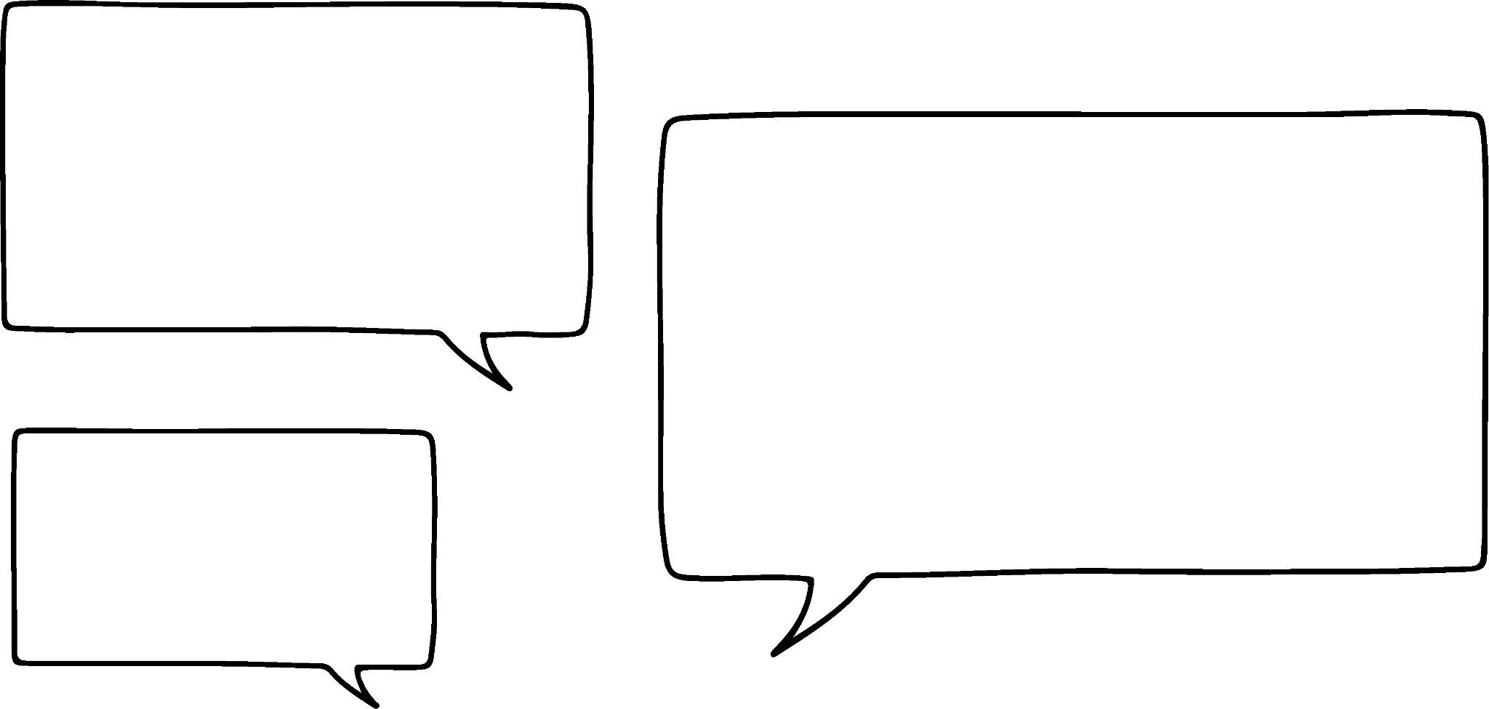
Recording and using data
There are other less technical ways to measure effort for people just taking up regular exercise.
RPE Chart (Rate of perceived exertion)
10 | Max effort | Impossible to continue Out of breath Unable to talk
9 | Very hard | Hard to maintain Can barely breathe Speaking single words
7-8 | Vigorous | Verge of uncomfortable Short of breath, single sentences
4-6 | Moderate | Could continue for hours Breathing heavy, short conversation
2-3 | Light | Easy to maintain for hours Can maintain conversation easily
1 | Very light | Anything other than sleeping e.g. Sitting watching T.V.
Coaches like me will use an RPE chart to plan your training sessions Jacob.
Coach Lucas

Slide 19
Recording and using data
RPE Chart (Rate of perceived exertion)
10 | Max effort | Impossible to continue Out of breath Unable to talk
9 | Very hard | Hard to maintain Can barely breathe Speaking single words
7-8 | Vigorous | Verge of uncomfortable Short of breath, single sentences
4-6 | Moderate | Could continue for hours Breathing heavy, short conversation
2-3 | Light | Easy to maintain for hours Can maintain conversation easily
1 | Very light | Anything other than sleeping e.g. Sitting watching T.V.
Is skateboarding good exercise? I fancy taking that up.
That’s great exercise! It will vary between feeling like a 3, 4, or 5
Coach Lucas

Slide 20
Recording and using data
Where do you think these activities would be on the chart for someone just taking up exercise?
RPE Chart (Rate of perceived exertion)
10 | Max effort | Impossible to continue Out of breath Unable to talk
9 | Very hard | Hard to maintain Can barely breathe Speaking single words
7-8 | Vigorous | Verge of uncomfortable Short of breath, single sentences
4-6 | Moderate | Could continue for hours Breathing heavy, short conversation
2-3 | Light | Easy to maintain for hours Can maintain conversation easily
1 | Very light | Anything other than sleeping e.g. Sitting watching T.V.
Walking on a treadmill
Walking up a steep hill
10 minutes cycling to a friend’s house
2 minutes intense trampolining
Gaming

Slide 21
Recording and using data
If you’re just starting I don’t want to see a 9 or 10 just yet!
RPE Chart (Rate of perceived exertion)
10 | Max effort | Impossible to continue Out of breath Unable to talk
9 | Very hard | Hard to maintain Can barely breathe Speaking single words
7-8 | Vigorous | Verge of uncomfortable Short of breath, single sentences
4-6 | Moderate | Could continue for hours Breathing heavy, short conversation
2-3 | Light | Easy to maintain for hours Can maintain conversation easily
1 | Very light | Anything other than sleeping e.g. Sitting watching T.V.
Coach Lucas
2 minutes intense trampolining
Walking up a steep hill
Walking on a treadmill
10 minutes cycling
Gaming

Slide 22
Recording and using data
Coach Lucas calculates averages to monitor Sofia’s performances in the 800 m
Week | 1 | 2 | 3 | 4 | 5 | 6 | 7 | 8 | 9 | 10
Time (sec) | 136 | 132 | 138 | 132 | 136 | 128 | 138 | 130 | 126 | 132
Mode: 132 sec
So I’m most likely to run a 132 but, I might run a 138 That’s not enough to beat my competitors!
I can calculate the averages for Sofia’s times.
Median: 132 sec
Mean: 132.8 sec
Relax. I know you are improving. Have you heard of three-point moving averages?
Coach Lucas
Sporty Sofia

Slide 23
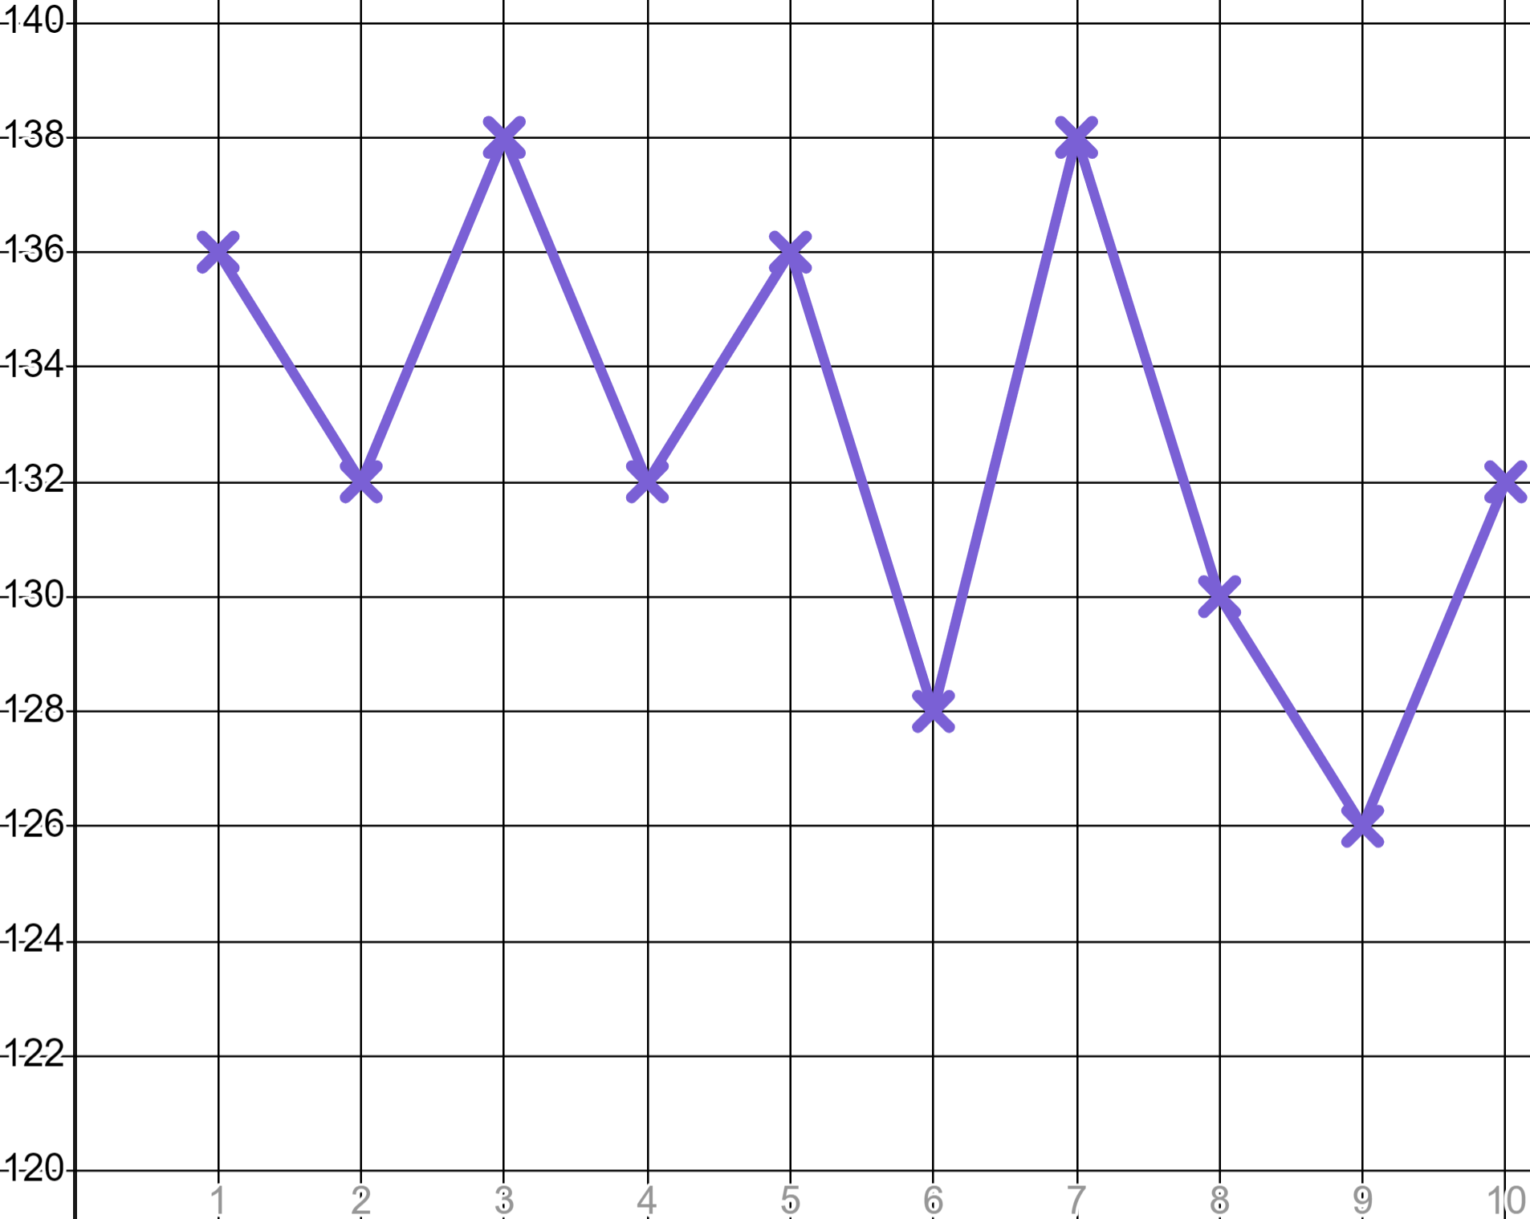
Recording and using data
We can graph Sofia’s times.
Week | 1 | 2 | 3 | 4 | 5 | 6 | 7 | 8 | 9 | 10
Time (sec) | 136 | 132 | 138 | 132 | 136 | 128 | 138 | 130 | 126 | 132
The line is erratic.
Is it going to go back up?
Will it go down next?
Is Sofia improving?
Time (s)
The pattern, the trend, is easier to see if we plot a three-point moving average.
Wk

Slide 24
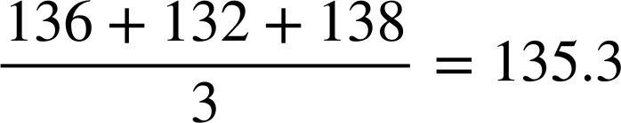
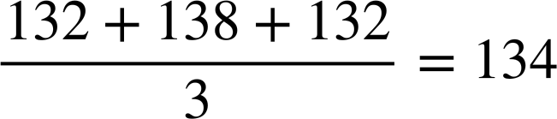
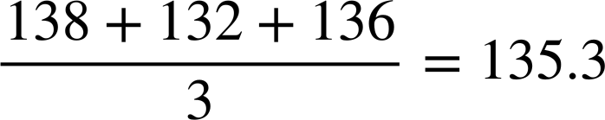
Recording and using data
Week | 1 | 2 | 3 | 4 | 5 | 6 | 7 | 8 | 9 | 10
Time (sec) | 136 | 132 | 138 | 132 | 136 | 128 | 138 | 130 | 126 | 132
 |  | 135 | 134 | 135
 |  | 135
 |  | 135 | 134
Take the average of three points.
Time (s)
✖
✖
✖
Wk

Slide 25
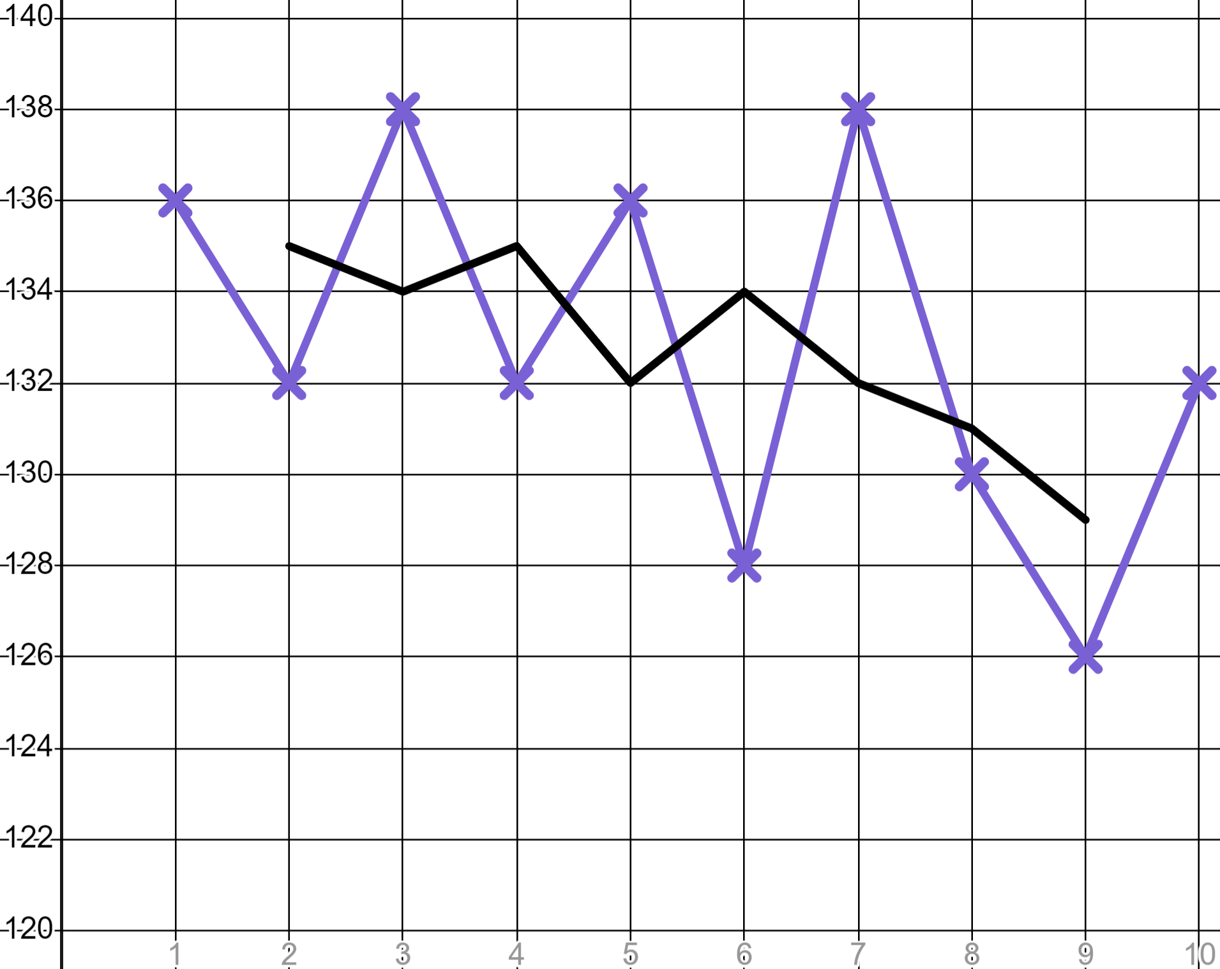
Recording and using data
Week | 1 | 2 | 3 | 4 | 5 | 6 | 7 | 8 | 9 | 10
Time (sec) | 136 | 132 | 138 | 132 | 136 | 128 | 138 | 130 | 126 | 132
 |  | 135 | 134 | 135 | 132 | 134 | 132 | 131 | 129
After populating the whole table and plotting all three-point moving averages…
Time (s)
✖
✖
✖
✖
✖
✖
✖
We see a far smoother line with a clear trend moving downward.
✖
Sofia is improving over time.
Wk

Slide 26
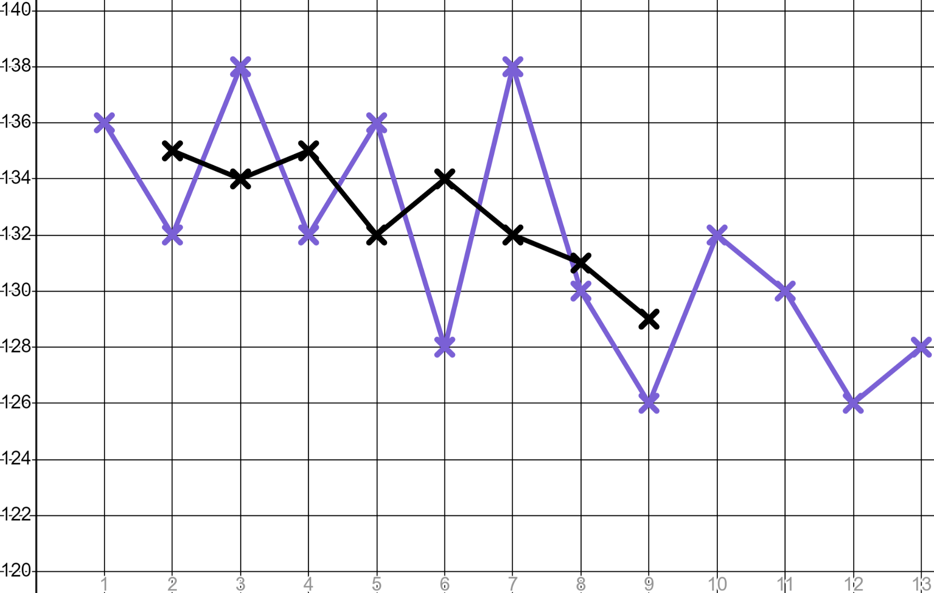
Recording and using data
Week | 1 | 2 | 3 | 4 | 5 | 6 | 7 | 8 | 9 | 10 | 11 | 12 | 13
Time (sec) | 136 | 132 | 138 | 132 | 136 | 128 | 138 | 130 | 126 | 132 | 130 | 126 | 128
 |  | 135 | 134 | 135 | 132 | 134 | 132 | 131 | 129
Find the remaining three-point moving averages and continue Sofia’s trend line to check that she has continued to improve.
Time (s)
Wk

Slide 27
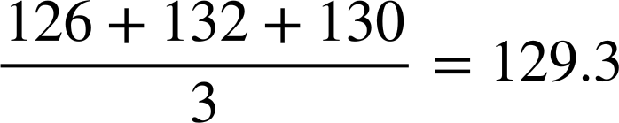
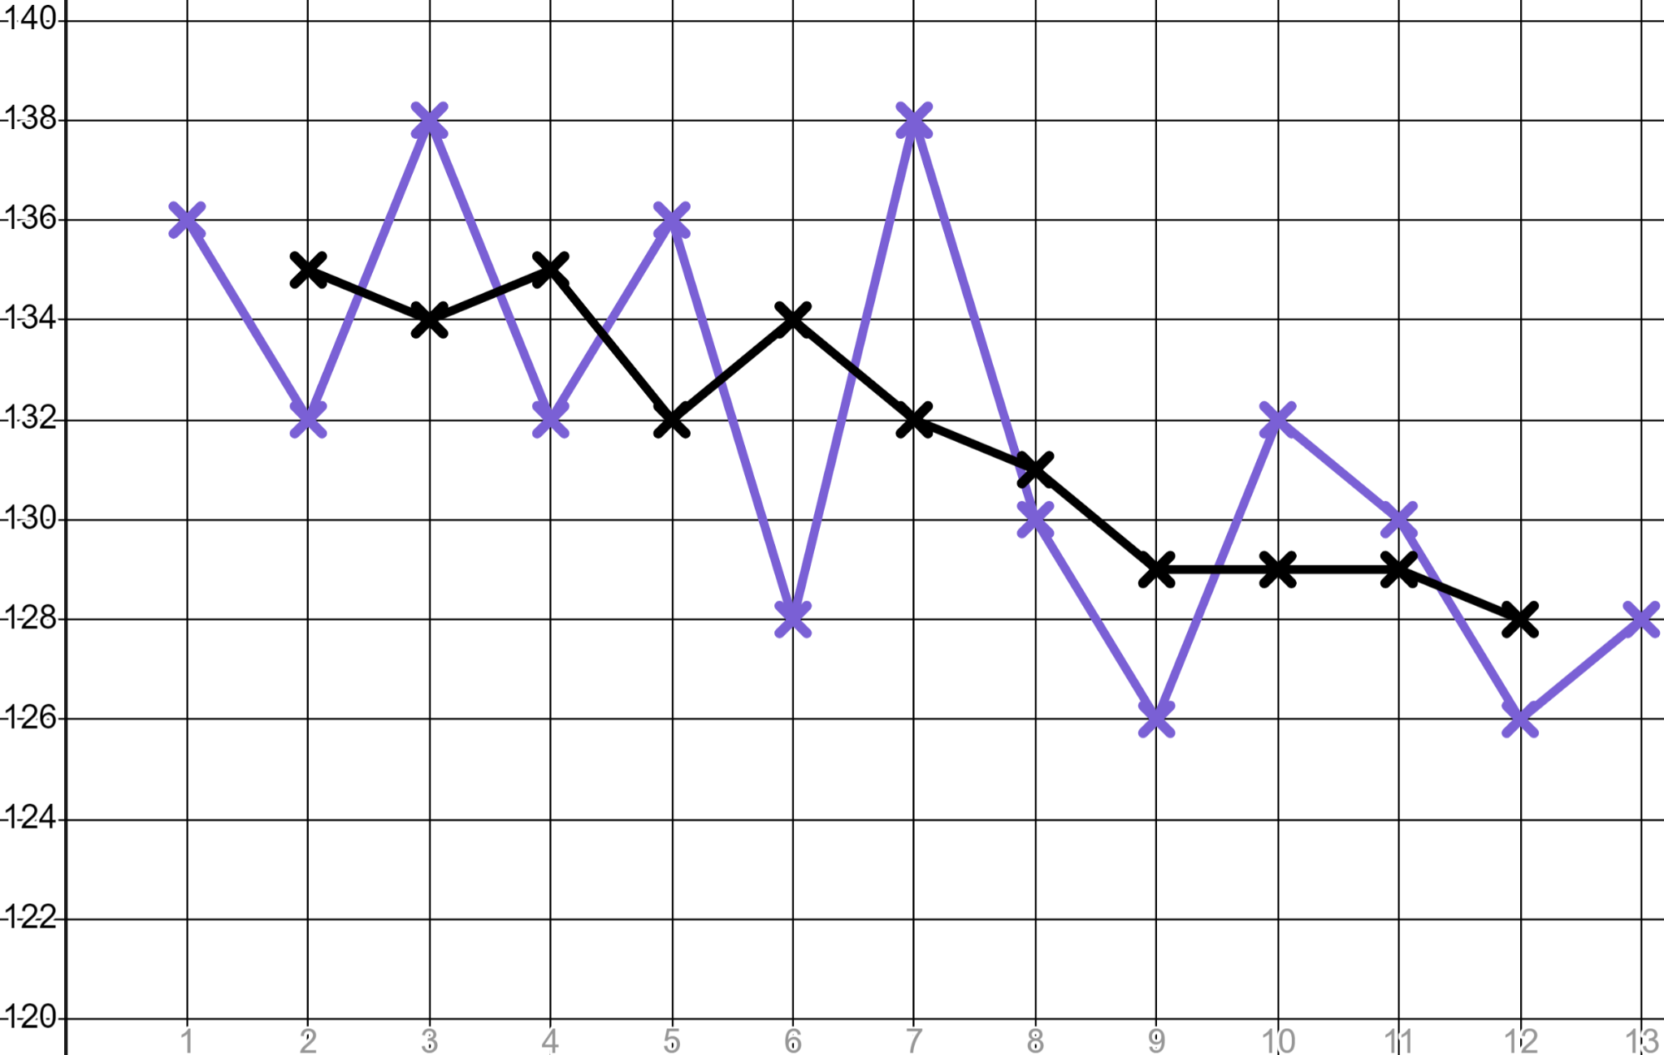
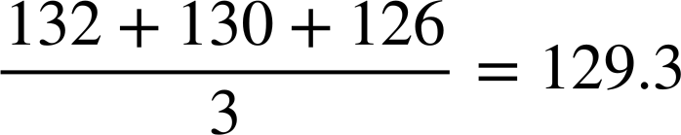
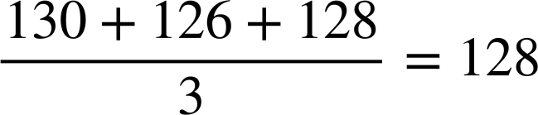
Recording and using data
Week | 1 | 2 | 3 | 4 | 5 | 6 | 7 | 8 | 9 | 10 | 11 | 12 | 13
Time (sec) | 136 | 132 | 138 | 132 | 136 | 128 | 138 | 130 | 126 | 132 | 130 | 126 | 128
 |  | 135 | 134 | 135 | 132 | 134 | 132 | 131 | 129 | 129
 |  | 135 | 134 | 135 | 132 | 134 | 132 | 131 | 129 | 129 | 129 | 128
 |  | 135 | 134 | 135 | 132 | 134 | 132 | 131 | 129 |  | 129
Time (s)
Sofia has continued to improve. Her rate of improvement has slowed but that
is not unusual for high performers as they near their maximum potential.

Slide 28
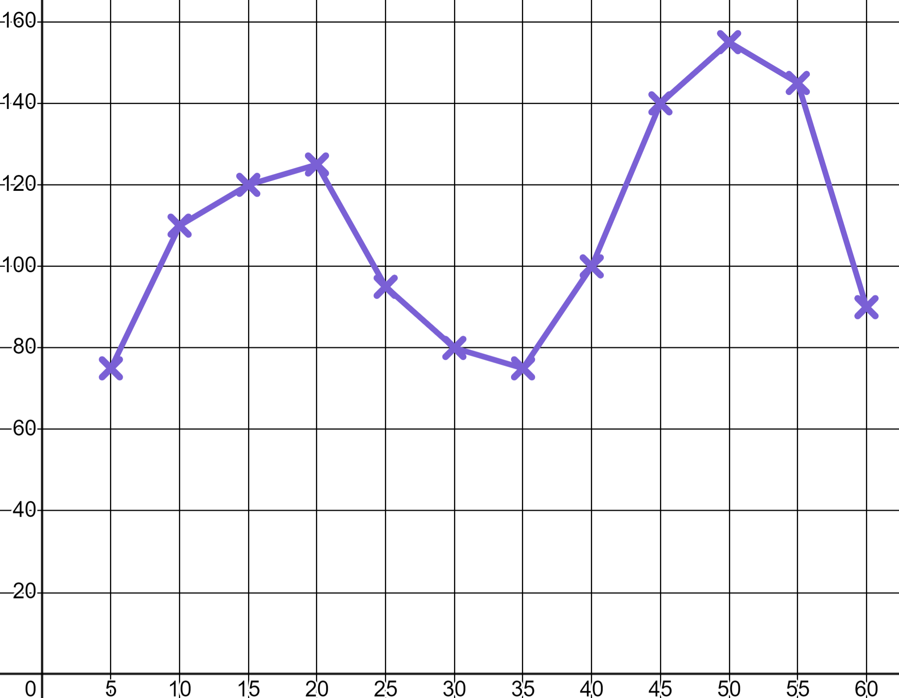
Recording and using data
1) a) Jacob goes skateboarding and his watch records his b.p.m.
Write at least three sentences to describe Jacob’s skating session. Use words like ‘moderate intensity’ and ‘high intensity’.
b.p.m.
T (min)

Slide 29
Recording and using data
1) b) Rank these three moments with a numerical value from the trainers’ RPE chart.
RPE Chart (Rate of perceived exertion)
10 | Max effort | Impossible to continue Out of breath Unable to talk
9 | Very hard | Hard to maintain Can barely breathe Speaking single words
7-8 | Vigorous | Verge of uncomfortable Short of breath, single sentences
4-6 | Moderate | Could continue for hours Breathing heavy, short conversation
2-3 | Light | Easy to maintain for hours Can maintain conversation easily
1 | Very light | Anything other than sleeping e.g. Sitting watching T.V.
b.p.m.
T (min)

Slide 30
Recording and using data
2) Sporty Sofia is filling in a target heart rate chart for older members of her family to use whilst exercising.
Your maximum heart rate is 220 b.p.m. minus age
Target heart rate for moderate exercise is 50 − 70% of maximum
Target heart rate for high intensity exercise is 70 − 85% of maximum
Age | Moderate exercise min | High intensity starts | High intensity max
20 | 100 | 140 | 170
30 | 95 |  | 161.5
50 |  | 119
 |  |  | 127.5
Fill in the blanks in the table.

Slide 31
Recording and using data
3) Aisha is trying to improve her 400 metre time. Here are her best times over 10 weeks of training.
Athletic Aisha
Week | 1 | 2 | 3 | 4 | 5 | 6 | 7 | 8 | 9 | 10
Time (sec) | 73 | 70 | 66 | 73 | 69 | 65 | 70 | 64 | 67 | 63
a) Calculate the mean, mode and median of her times.
b) Write a sentence explaining why these three averages alone do not inform you as to whether Aisha is improving.

Slide 32
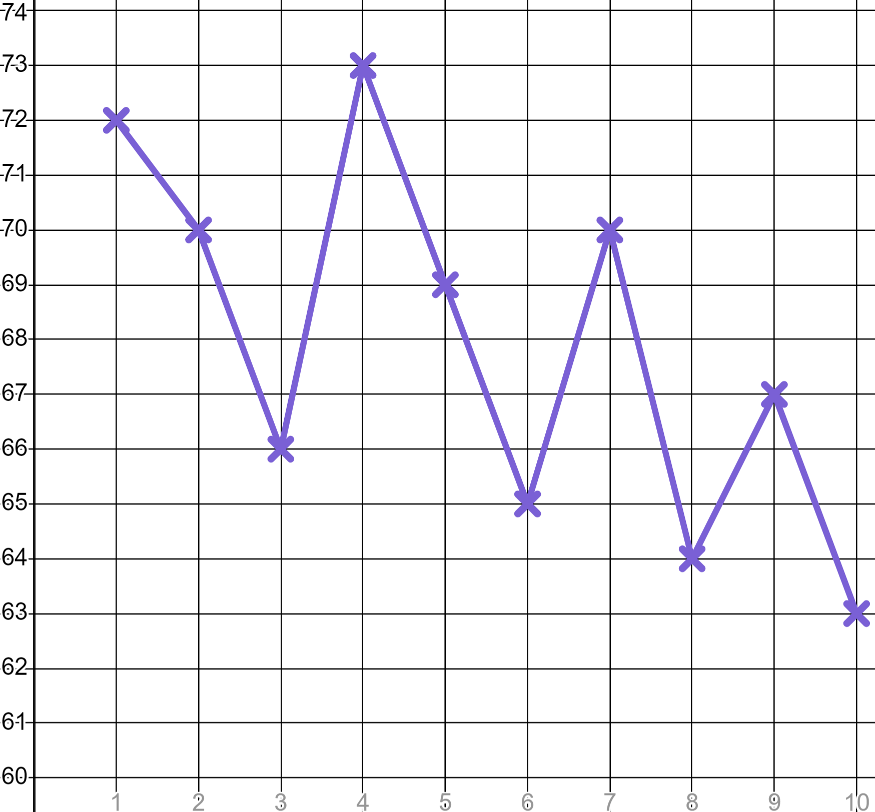
Recording and using data
3)
Week | 1 | 2 | 3 | 4 | 5 | 6 | 7 | 8 | 9 | 10
Time (sec) | 73 | 70 | 66 | 73 | 69 | 65 | 70 | 64 | 67 | 63
 | ✖ | 70
c) Populate the table of three-point moving averages (to the nearest whole number). The first one is done for you.
d) Graph Aisha’s three-point moving averages and write a comment as to whether she is improving.
Time (s)
e) Use your three-point moving averages to make a prediction as to when Aisha might break the 60 second barrier.
Wk

Slide 33
Recording and using data
1) a) Jacob goes skateboarding and his watch records his b.p.m.
Write at least three sentences to describe Jacob’s skating session. Use words like ‘moderate intensity’ and ‘high intensity’.
b.p.m.
You might have written: “Jacob spent the first 20 minutes skating at a moderate intensity. He then had a period of rest. He finished with a period of high intensity where his heart rate was at its max”.
T (min)

Slide 34
Recording and using data
1) b) Rank these three moments with a numerical value from the trainers’ RPE chart.
RPE Chart (Rate of perceived exertion)
10 | Max effort | Impossible to continue Out of breath Unable to talk
9 | Very hard | Hard to maintain Can barely breathe Speaking single words
7-8 | Vigorous | Verge of uncomfortable Short of breath, single sentences
4-6 | Moderate | Could continue for hours Breathing heavy, short conversation
2-3 | Light | Easy to maintain for hours Can maintain conversation easily
1 | Very light | Anything other than sleeping e.g. Sitting watching T.V.
7 or 8
b.p.m.
4 to 6
1
T (min)

Slide 35
Recording and using data
2) Sporty Sofia is filling in a target heart rate chart for older members of her family to use whilst exercising.
Your maximum heart rate is 220 b.p.m. minus age
Target heart rate for moderate exercise is 50 − 70% of maximum
Target heart rate for high intensity exercise is 70 − 85% of maximum
Age | Moderate exercise min | High intensity starts | High intensity max
20 | 100 | 140 | 170
30 | 95 |  | 161.5
50 |  | 119
 |  |  | 127.5
Age | Moderate exercise min | High intensity starts | High intensity max
20 | 100 | 140 | 170
30 | 95 | 133 | 161.5
50 | 85 | 119 | 144.5
70 | 75 | 105 | 127.5
Fill in the blanks in the table.

Slide 36
Recording and using data
3) Aisha is trying to improve her 400 metre time. Here are her best times over 10 weeks of training.
Athletic Aisha
Week | 1 | 2 | 3 | 4 | 5 | 6 | 7 | 8 | 9 | 10
Time (sec) | 73 | 70 | 66 | 73 | 69 | 65 | 70 | 64 | 67 | 63
a) Calculate the mean, mode and median of her times.
Mode: 70 sec
Median: 68 sec
Mean: 67.9 sec
b) Write a sentence explaining why these three averages alone do not inform you as to whether Aisha is improving.
You might have said, “These averages are calculated over the whole ten weeks. They give us important information but show nothing about progress over time.”

Slide 37
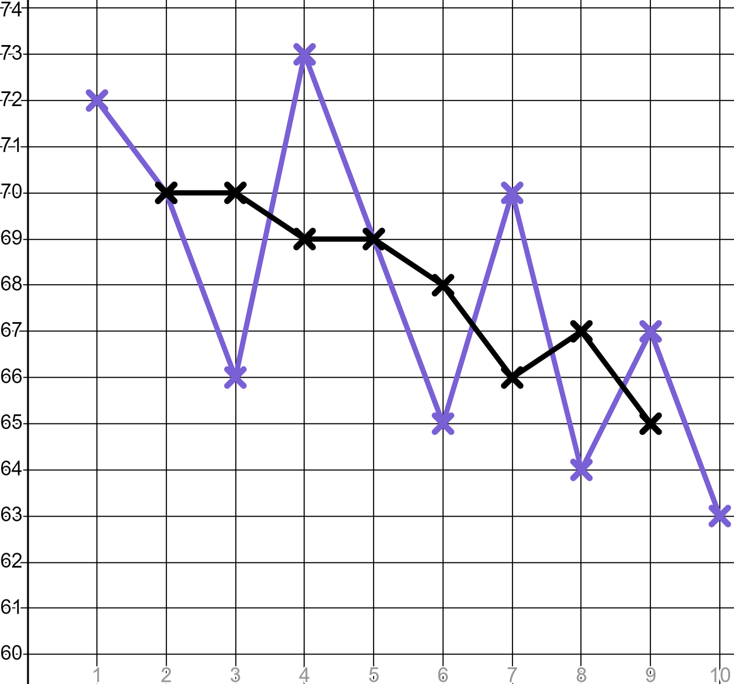
Recording and using data
3)
Week | 1 | 2 | 3 | 4 | 5 | 6 | 7 | 8 | 9 | 10
Time (sec) | 73 | 70 | 66 | 73 | 69 | 65 | 70 | 64 | 67 | 63
 | ✖ | 70
Week | 1 | 2 | 3 | 4 | 5 | 6 | 7 | 8 | 9 | 10
Time (sec) | 73 | 70 | 66 | 73 | 69 | 65 | 70 | 64 | 67 | 63
 | ✖ | 70 | 70 | 69 | 69 | 68 | 66 | 67 | 65 | ✖
c) Populate the table of three-point moving averages (to the nearest whole number). The first one is done for you.
d) Graph Aisha’s three-point moving averages and write a comment as to whether she is improving.
Time (s)
You might have said, “Aisha’s three-point moving averages are trending downwards; she is improving.”
Wk

Slide 38
Recording and using data
3)
Week | 1 | 2 | 3 | 4 | 5 | 6 | 7 | 8 | 9 | 10
Time (sec) | 73 | 70 | 66 | 73 | 69 | 65 | 70 | 64 | 67 | 63
 | ✖ | 70
Week | 1 | 2 | 3 | 4 | 5 | 6 | 7 | 8 | 9 | 10
Time (sec) | 73 | 70 | 66 | 73 | 69 | 65 | 70 | 64 | 67 | 63
 | ✖ | 70 | 70 | 69 | 69 | 68 | 66 | 67 | 65 | ✖
e) Use your three-point moving averages to make a prediction as to when Aisha might break the 60 second barrier.
You might have said, “Aisha’s three-point moving averages are improving by approximately half a second per week. If this trend continues she should break the 60 second barrier in another ten weeks.”
Time (s)
Wk

Slide 39
Sports coaching
Recording and using data
Using data to plan training sessions

Slide 40
Using data to plan training sessions
Sports coaches use data to plan training sessions which fit the training needs of the athlete.
Research has told us that different types of athletes have differing training needs so should be training differently.
The training plan needs to meet the performance targets of the athlete.

Slide 41
Using data to plan training sessions
Training Goal | Sets | Reps | Rest Period | Intensity
Endurance | 3 - 4 | > 12 | Up to 30 seconds | < 67% of 1RM
Muscle leanness | 3 - 6 | 6 - 12 | 30 to 90 seconds | 67 - 85% of 1RM
Muscle strength | 4 - 6 | < 6 | 2 to 5 minutes | > 85% of 1RM
This table tells you how three different types of athletes should train.

Slide 42
Using data to plan training sessions
Training Goal | Sets | Reps | Rest Period | Intensity
Endurance | 3 - 4 | > 12 | Up to 30 seconds | < 67% of 1RM
Muscle leanness | 3 - 6 | 6 - 12 | 30 to 90 seconds | 67 - 85% of 1RM
Muscle strength | 4 - 6 | < 6 | 2 to 5 minutes | > 85% of 1RM
‘Rep’ is short for ‘Repetition’; that is a single repetition of an exercise. Example, one press-up could be one ‘Rep’
A ‘Set’ is a collection of ‘Reps’. Example, ten press-ups could be one ‘Set’
The ‘Rest Period’ is the time spent recovering between ‘Sets’

Slide 43
Using data to plan training sessions
Training Goal | Sets | Reps | Rest Period | Intensity
Endurance | 3 - 4 | > 12 | Up to 30 seconds | < 67% of 1RM
Muscle leanness | 3 - 6 | 6 - 12 | 30 to 90 seconds | 67 - 85% of 1RM
Muscle strength | 4 - 6 | < 6 | 2 to 5 minutes | > 85% of 1RM
‘Intensity’ is how hard your body is working during an exercise
‘1RM’ is an abbreviation of ‘One Rep Max’, i.e. the maximum that can be achieved in one repetition of an exercise by an athlete

Slide 44
Using data to plan training sessions
Training Goal | Sets | Reps | Rest Period | Intensity
Endurance | 3 - 4 | > 12 | Up to 30 seconds | < 67% of 1RM
Muscle leanness | 3 - 6 | 6 - 12 | 30 to 90 seconds | 67 - 85% of 1RM
Muscle strength | 4 - 6 | < 6 | 2 to 5 minutes | > 85% of 1RM
A long distance runner might have the training goal of ‘Endurance’
A decathlete might be training for ‘Muscle leanness’ because they need to perform a variety of athletic challenges
A weight lifter might be training for ‘Muscle strength’

Slide 45
Using data to plan training sessions
Training Goal | Sets | Reps | Rest Period | Intensity
Endurance | 3 - 4 | > 12 | Up to 30 seconds | < 67% of 1RM
Muscle leanness | 3 - 6 | 6 - 12 | 30 to 90 seconds | 67 - 85% of 1RM
Muscle strength | 4 - 6 | < 6 | 2 to 5 minutes | > 85% of 1RM
Someone with the training goal muscle strength will typically do the fewest reps.
Someone with the training goal __________ will typically do the fewest sets.
Someone training at 70% of 1RM is training towards ___________.
Someone with the training goal muscle strength will typically do the fewest reps.
Someone with the training goal endurance will typically do the fewest sets.
Someone training at 70% of 1RM is training towards ___________.
Someone with the training goal muscle strength will typically do the fewest reps.
Someone with the training goal endurance will typically do the fewest sets.
Someone training at 70% of 1RM is training towards muscle leanness .
Someone with the training goal ____________ will typically do the fewest reps.
Someone with the training goal __________ will typically do the fewest sets.
Someone training at 70% of 1RM is training towards ___________.

Slide 46
Using data to plan training sessions
Training Goal | Sets | Reps | Rest Period | Intensity
Endurance | 3 - 4 | > 12 | Up to 30 seconds | < 67% of 1RM
Muscle leanness | 3 - 6 | 6 - 12 | 30 to 90 seconds | 67 - 85% of 1RM
Muscle strength | 4 - 6 | < 6 | 2 to 5 minutes | > 85% of 1RM
Lucas is putting together a training plan for his older sister who is trying to get into competitive powerlifting. Lucas’ sister is over 18 so her body is fully developed, therefore she can train as suggested above for muscle strength.
We are going to start with an easier plan for a month, then build up. Her current 1RM is 120 kg

Slide 47
Using data to plan training sessions
Training Goal | Sets | Reps | Rest Period | Intensity
Endurance | 3 - 4 | > 12 | Up to 30 seconds | < 67% of 1RM
Muscle leanness | 3 - 6 | 6 - 12 | 30 to 90 seconds | 67 - 85% of 1RM
Muscle strength | 4 - 6 | < 6 | 2 to 5 minutes | > 85% of 1RM
Starter plan:
Intensity:
87.5% × 120 = 105 kg
Sets/Reps:
4 sets of 4 reps
Rest periods:
5 minutes between sets
We are going to start with an easier plan for a month, then build up. Her current 1RM is 120 kg

Slide 48
Using data to plan training sessions
Training Goal | Sets | Reps | Rest Period | Intensity
Endurance | 3 - 4 | > 12 | Up to 30 seconds | < 67% of 1RM
Muscle leanness | 3 - 6 | 6 - 12 | 30 to 90 seconds | 67 - 85% of 1RM
Muscle strength | 4 - 6 | < 6 | 2 to 5 minutes | > 85% of 1RM
Improver plan:
Intensity:
87.5% × 120 = 105 kg
Sets/Reps:
6 sets of 4 reps
Rest periods:
4 minutes between sets
It’s been a month and she is training well. We are stepping up the training plan.

Slide 49
Using data to plan training sessions
Training Goal | Sets | Reps | Rest Period | Intensity
Endurance | 3 - 4 | > 12 | Up to 30 seconds | < 67% of 1RM
Muscle leanness | 3 - 6 | 6 - 12 | 30 to 90 seconds | 67 - 85% of 1RM
Muscle strength | 4 - 6 | < 6 | 2 to 5 minutes | > 85% of 1RM
Expert plan:
This is not the only solution but your solution should have included an increase in intensity/sets/reps and a reduction of rest time.
Intensity:
90% × 120 = 108 kg
__________
Sets/Reps:
6 sets of 5 reps
__________
Rest periods:
2 minutes between sets
__________
What do you think an expert plan will look like for muscle strength development for someone with a 1RM of 120 kg?

Slide 50
Using data to plan training sessions
Training Goal | Sets | Reps | Rest Period | Intensity
Endurance | 3 - 4 | > 12 | Up to 30 seconds | < 67% of 1RM
Muscle leanness | 3 - 6 | 6 - 12 | 30 to 90 seconds | 67 - 85% of 1RM
Muscle strength | 4 - 6 | < 6 | 2 to 5 minutes | > 85% of 1RM
Expert plan:
Intensity:
110% × 120 = 132 kg
Exceeds the max.
Sets/Reps:
6 sets of 6 reps
Reps should be <6
90 seconds between sets
Min rest is 2 mins for muscle strength.
Rest periods:
What do you think is wrong with this plan for muscle strength development for someone with a 1RM of 120 kg?

Slide 51
Using data to plan training sessions
Training Goal | Sets | Reps | Rest Period | Intensity
Endurance | 3 - 4 | > 12 | Up to 30 seconds | < 67% of 1RM
Muscle leanness | 3 - 6 | 6 - 12 | 30 to 90 seconds | 67 - 85% of 1RM
Muscle strength | 4 - 6 | < 6 | 2 to 5 minutes | > 85% of 1RM
1) Sofia’s older brother is training for a heptathlon therefore he needs to develop muscle leanness. He is working on his bench press and has a 1RM of 80 kg. Create for him a:
a) Starter plan
b) Improver plan
c) Expert plan

Slide 52
Using data to plan training sessions
Training Goal | Sets | Reps | Rest Period | Intensity
Endurance | 3 - 4 | > 12 | Up to 30 seconds | < 67% of 1RM
Muscle leanness | 3 - 6 | 6 - 12 | 30 to 90 seconds | 67 - 85% of 1RM
Muscle strength | 4 - 6 | < 6 | 2 to 5 minutes | > 85% of 1RM
2) a) Someone with a 1RM of 125 kg in deadlifting is doing reps of 76 kg. What is their training goal?
b) Someone tells you they did 60 repetitions across all of their sets. What could their training goal be?
c) Someone tells you they are intensely training for muscle leanness and are deadlifting 136 kg. What is their 1RM?

Slide 53
Using data to plan training sessions
Training Goal | Sets | Reps | Rest Period | Intensity
Endurance | 3 - 4 | > 12 | Up to 30 seconds | < 67% of 1RM
Muscle leanness | 3 - 6 | 6 - 12 | 30 to 90 seconds | 67 - 85% of 1RM
Muscle strength | 4 - 6 | < 6 | 2 to 5 minutes | > 85% of 1RM
1) Sofia’s older brother is training for a heptathlon therefore he needs to develop muscle leanness. He is working on his bench press and has a 1RM of 80 kg. Create for him a:
a) Starter plan
b) Improver plan
c) Expert plan

Slide 54
Using data to plan training sessions
Training Goal | Sets | Reps | Rest Period | Intensity
Endurance | 3 - 4 | > 12 | Up to 30 seconds | < 67% of 1RM
Muscle leanness | 3 - 6 | 6 - 12 | 30 to 90 seconds | 67 - 85% of 1RM
Muscle strength | 4 - 6 | < 6 | 2 to 5 minutes | > 85% of 1RM
a) Starter plan
b) Improver plan
c) Expert plan
Intensity:
70% × 80 = 56 kg
75% × 80 = 60 kg
75% × 80 = 60 kg
Sets/Reps:
3 sets of 6 reps
3 sets of 6 reps
6 sets of 12 reps
Rest periods:
90 seconds
90 seconds
30 seconds
This is not the only solution. Your solution should start at the easier ends of the bounds and progress to greater difficulty.

Slide 55

Using data to plan training sessions
Training Goal | Sets | Reps | Rest Period | Intensity
Endurance | 3 - 4 | > 12 | Up to 30 seconds | < 67% of 1RM
Muscle leanness | 3 - 6 | 6 - 12 | 30 to 90 seconds | 67 - 85% of 1RM
Muscle strength | 4 - 6 | < 6 | 2 to 5 minutes | > 85% of 1RM
2) a) Someone with a 1RM of 125 kg in deadlifting is doing reps of 76 kg. What is their training goal?
Intensity < 67% kg therefore training for endurance.

Slide 56
Using data to plan training sessions
Training Goal | Sets | Reps | Rest Period | Intensity
Endurance | 3 - 4 | > 12 | Up to 30 seconds | < 67% of 1RM
Muscle leanness | 3 - 6 | 6 - 12 | 30 to 90 seconds | 67 - 85% of 1RM
Muscle strength | 4 - 6 | < 6 | 2 to 5 minutes | > 85% of 1RM
b) Someone tells you they did 60 repetitions across all of their sets. What could their training goal be?
6 × 5 = 30 is the max reps for muscle strength so this can not be that.
4 sets of 15 reps is training for endurance.
3 sets of 20 reps is training for endurance.
6 sets of 10 reps is training for muscle leanness.
5 sets of 12 reps is training for muscle leanness.

Slide 57
Using data to plan training sessions
Training Goal | Sets | Reps | Rest Period | Intensity
Endurance | 3 - 4 | > 12 | Up to 30 seconds | < 67% of 1RM
Muscle leanness | 3 - 6 | 6 - 12 | 30 to 90 seconds | 67 - 85% of 1RM
Muscle strength | 4 - 6 | < 6 | 2 to 5 minutes | > 85% of 1RM
c) Someone tells you they are intensely training for muscle leanness and are deadlifting 136 kg. What is their 1RM?
Most intense level for muscle leanness is 85% of their 1RM
1RM × 0.85 = 136 kg therefore…
136 kg ÷ 0.85 = 160 kg

Slide 58
Sports coaching
Sports coaches use data to track performance of an athlete and demonstrate improvements.
They also use data to plan the training needs of an athlete to help their athletes improve.

Slide 59

© Oak National Academy 2024.
Produced in partnership with Mathematics in Education and Industry.
Licensed on the Open Government Licence v3.0, except where otherwise stated. See Oak terms and conditions.

